Slide 1
Looking to Listen at the Cocktail Party:
A Speaker-Independent Audio-Visual Model
for Speech Separation
ARIEL EPHRAT, Google Research and The Hebrew University of Jerusalem
INBAR MOSSERI, Google Research ORAN LANG, Google Research TALI DEKEL, Google Research
KEVIN WILSON, Google Research
AVINATAN HASSIDIM, Google Research
WILLIAM T. FREEMAN, Google Research
MICHAEL RUBINSTEIN, Google Research
姓名：程颖
学号：18110860006

Slide 2
Outlines
01
Background
02
Related Work
03
Dataset
04
Model
05
Experiments
06
Conclusion

Slide 3
1
Background

Slide 4
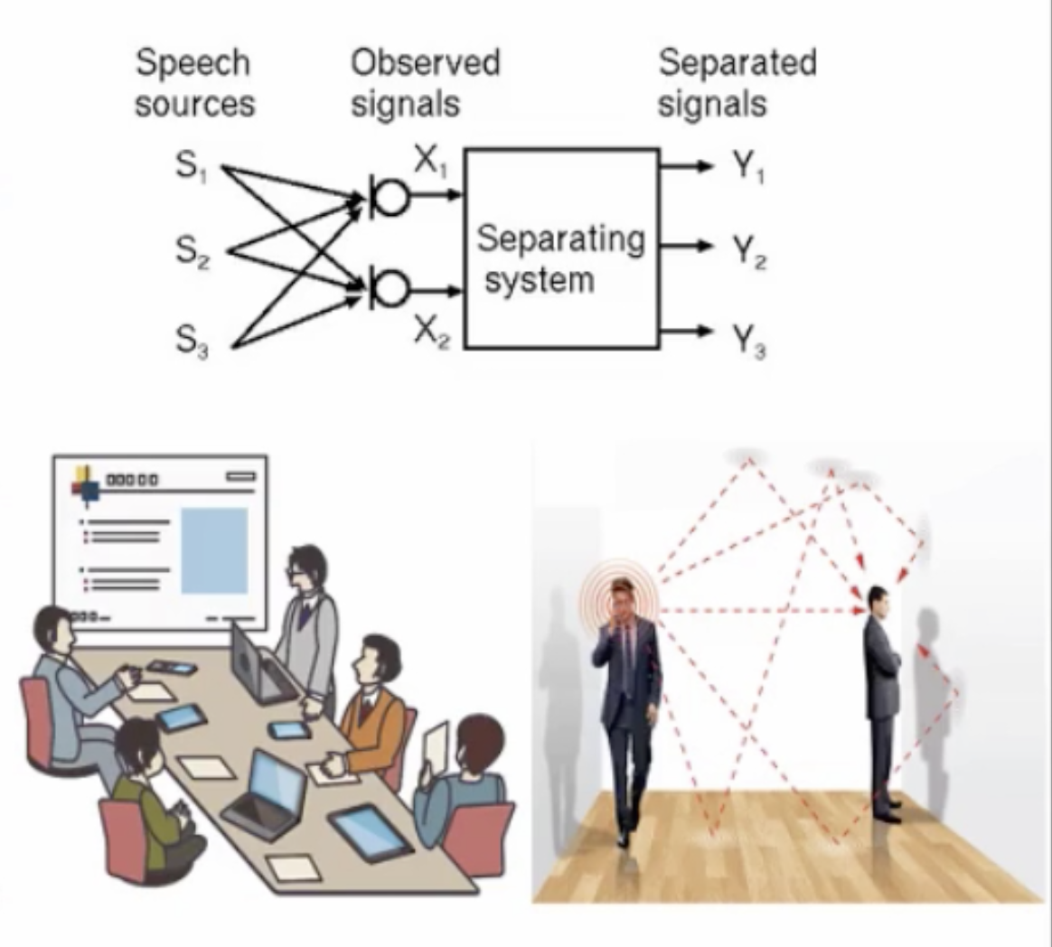
01
Background
Speech separation is from the “cocktail party problem”[Cherry, 1953]
Speech + Noise: Speech Enhancement
Speech + Speech: Speaker Separation
Reflection: Speech De-reverberation
We need speech separation for robust automatic speech recognition

Slide 5
2
Related Work

Slide 6

02
Related Work
Label Permutation Problem
Vision and Speech
Deep Clustering
Sparse Representations
Hershey et al. [2016] propose a method called deep clustering in which discriminatively- trained speech embeddings are used to cluster and separate the different sources.
Casanovas et al. [2010] perform AV source separation using sparse representations, which is limited due to dependence on active-alone regions to learn source characteristics, and the assumption that all the audio sources are seen on-screen.
01
01
Permutation Invariant
Multi-task CNN-based Model
Yu et al. [2017] introduced methods which successfully use a permutation invariant loss function to train a DNN.
Hou et al. [2018] propose a multi-task CNN-based model which outputs a denoised speech spectrogram as well a reconstruction of the input mouth region.
02
02

Slide 7
3
Dataset

Slide 8
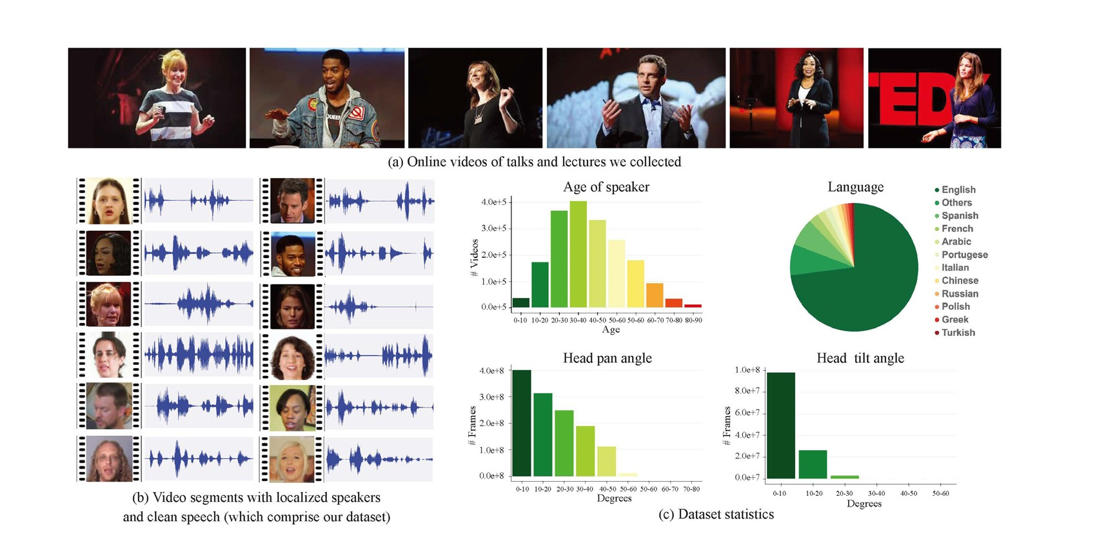
03
AVSpeech Dataset
原始数据是TED等讲座视频
• 音声 + 顔画像
• 3秒～10秒
• データ長 2000時間
• 生成はすべて自動化
• 元データは、TED等の講義ビデ
数据集包括说话人的脸部动画以及所对应的音频信息。

Slide 9
03
AVSpeech Dataset
年龄范围
语言种类
脸部左右偏移角度
脸部上下偏移角度

Slide 10
4
Model

Slide 11

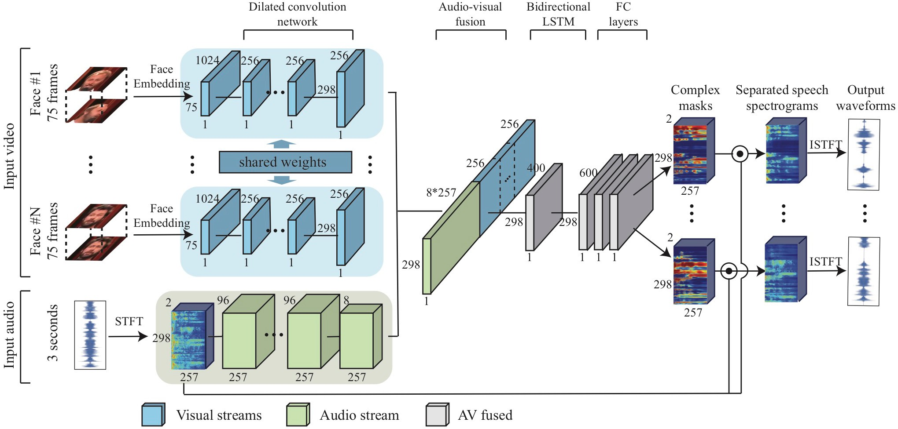
04
Model
Network Architecture

Slide 12
04
Model
Input / Output
Visual Streams
Output
Complex Spectrogram Mask for Each Speaker
Audio Stream (Mixture of Speech and background noise)

Slide 13
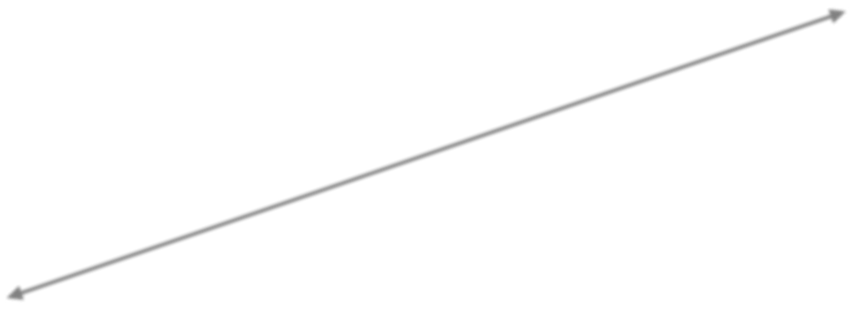
04
Model
Complex masks

Slide 14
04
Model
ISTFT
Obtain an isolated speech signal

Slide 15

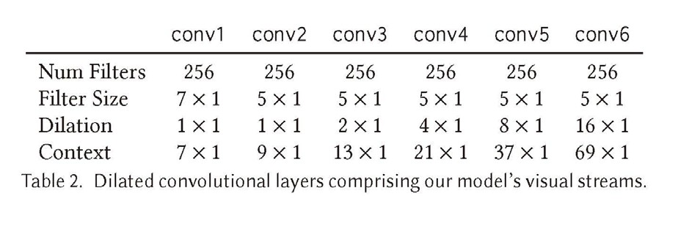
04
Model
Visual Streams
Network Architecture

Slide 16
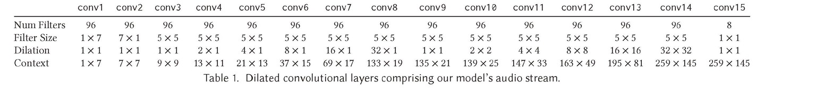
04
Model
Audio Streams
Network Architecture

Slide 17
04
Model
Audio-Visual Fusion
Network Architecture
The audio and visual streams are combined by concatenating the feature maps of each stream, which are subsequently fed into a BLSTM followed by three FC layers.

Slide 18
5
Experiments

Slide 19
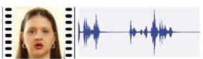
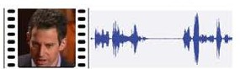
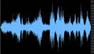
05
Experiments
Experiment Methods
How to create training/testing data?
Combine AVSPEECH Dataset (clean speech clips + corresponding faces) and AudioSet Dataset (noise) to create learning data / test data for different tasks.
AudioSet Dataset
(AudioSet consists of an expanding ontology of 632 audio event classes and a collection of 2,084,320 human-labeled 10-second sound clips drawn from YouTube videos.)
training / testing data
(two speaker +noise)
=
+
+
AVSPeech Dataset
AudioSet Dataset

Slide 20
05
Experiments
one speaker + noise
two speakers + noise
Audio only (one speech + noise)
AV -1 face (one speech + one face + noise)
Audio only (two speeches + noise)
AV -1 face (two speeches + one face + noise)
AV -2 face (two speeches + two faces + noise)
01
03
two clean speakers
three clean speakers
Audio only (two speeches)
AV -1 face (two speeches + one face)
AV -2 face (two speeches + two faces)
Audio only (three speeches)
AV -1 face (three speeches + one face)
AV -2 face (three speeches + two faces)
AV -3 face (three speeches + three faces)
02
04

Slide 21
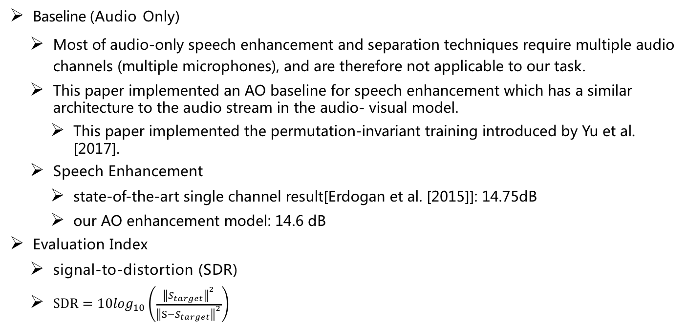
05
Experiments
Evaluation Methods
Baseline (Audio Only)
Most of audio-only speech enhancement and separation techniques require multiple audio channels (multiple microphones), and are therefore not applicable to our task.
This paper implemented an AO baseline for speech enhancement which has a similar architecture to the audio stream in the audio- visual model.
This paper implemented the permutation-invariant training introduced by Yu et al. [2017].
Speech Enhancement
state-of-the-art single channel result[Erdogan et al. [2015]]: 14.75dB
our AO enhancement model: 14.6 dB
Evaluation Index
signal-to-distortion (SDR)
$SDR=10\log_{10}\left(\frac{{\left\|S_{target}\right\|}^{2}}{{\left\|S−S_{target}\right\|}^{2}}\right)$

Slide 22
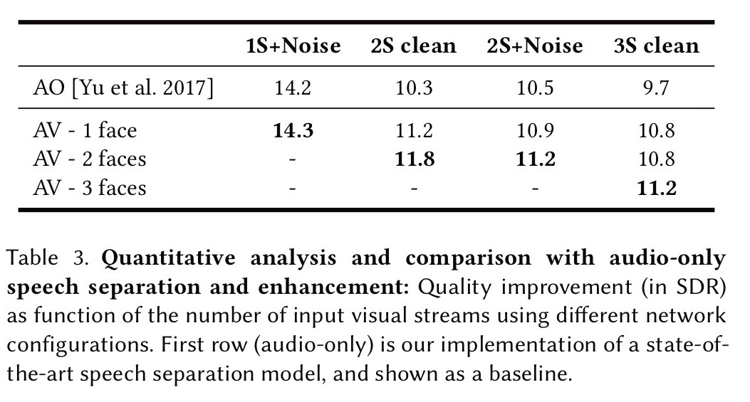
05
Experiments
Results
Audio-visual speech separation model performs
better than baseline under any conditions.

Slide 23
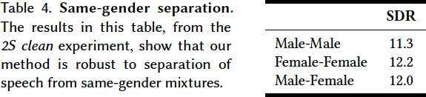
05
Experiments
Results
This model demonstrates its gender robustness.

Slide 24
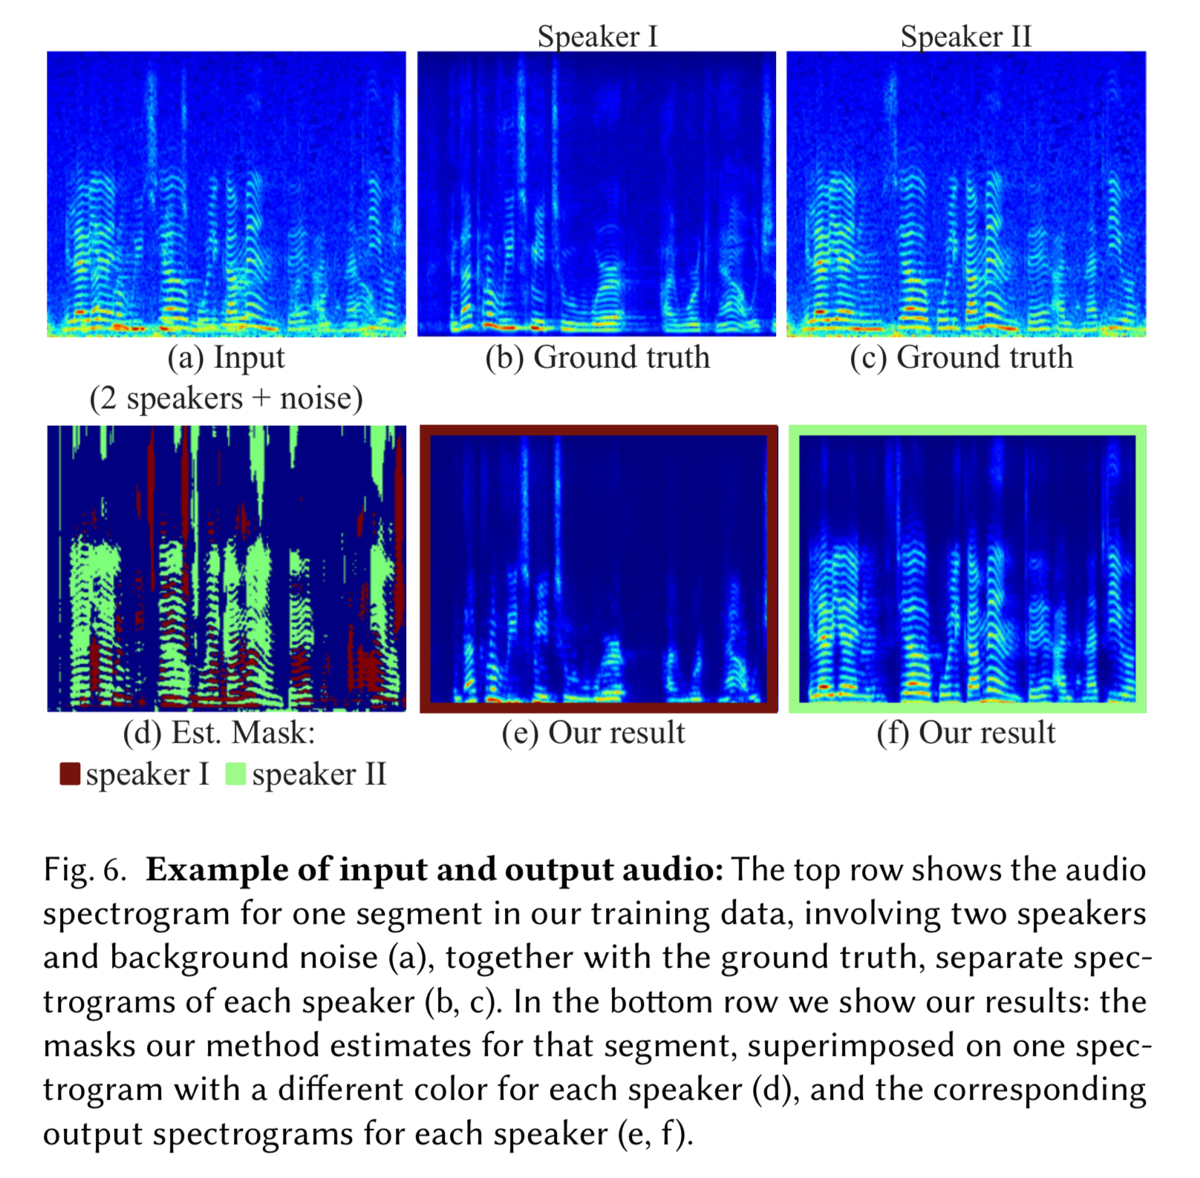
05
Experiments
Results
Fig.6.Example of input and output audio
The top row shows the audio spectrogram for one segment in our training data, involving two speakers and background noise (a), together with the ground truth, separate spectrograms of each speaker (b, c). In the bottom row we show our results: the masks our method estimates for that segment, superimposed on one spectrogram with a different color for each speaker (d), and the corresponding output spectrograms for each speaker (e, f).

Slide 25
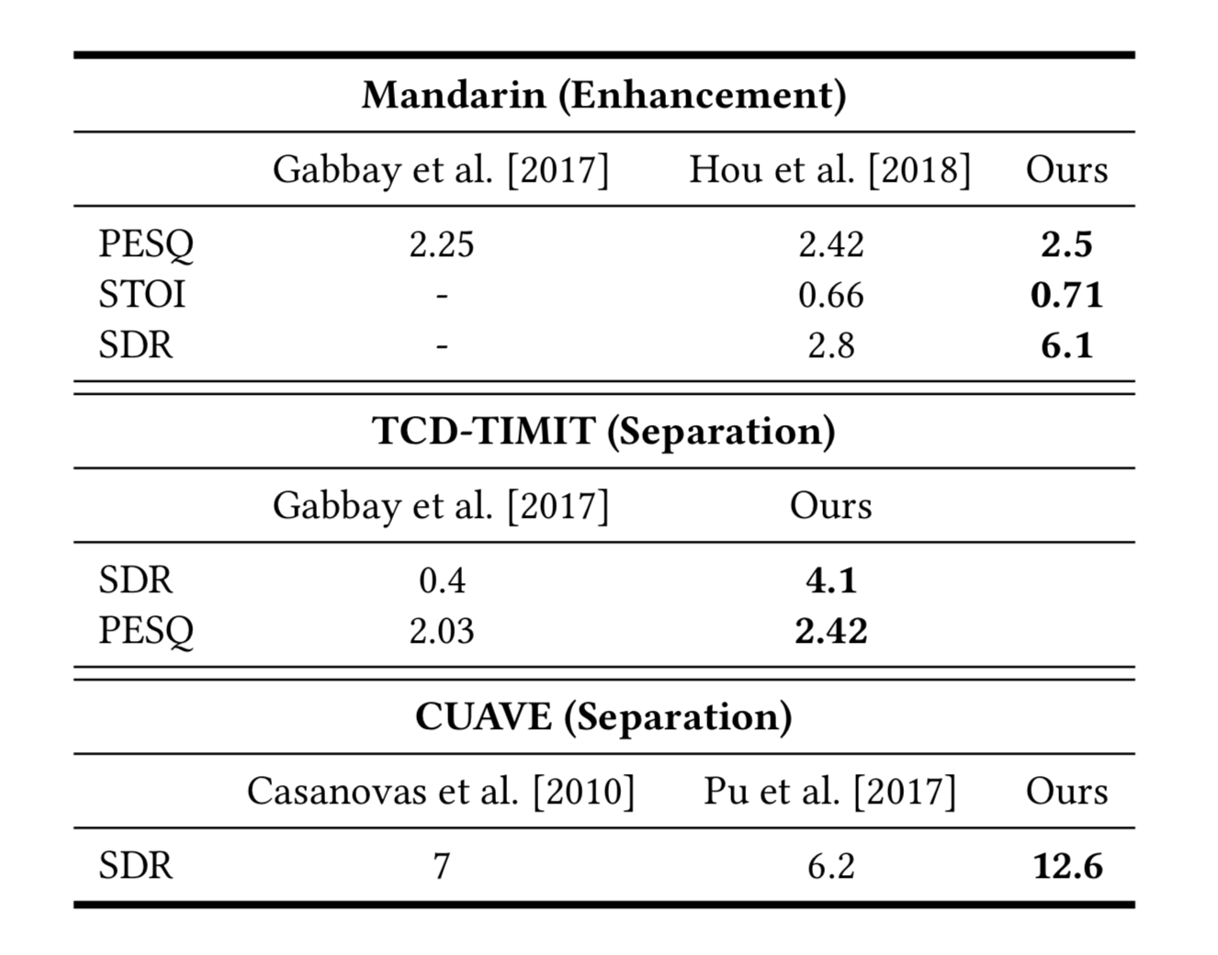
05
Experiments
comparison
Table 5. Comparison with existing audio-visual speech separation work.
We compare our speech separation and enhancement results on several datasets to those of previous work, using the evaluation protocols and objective scores reported in the original papers. Note that previous approaches are speaker-dependent, whereas our results are obtained by using a general, speaker-independent model.

Slide 26
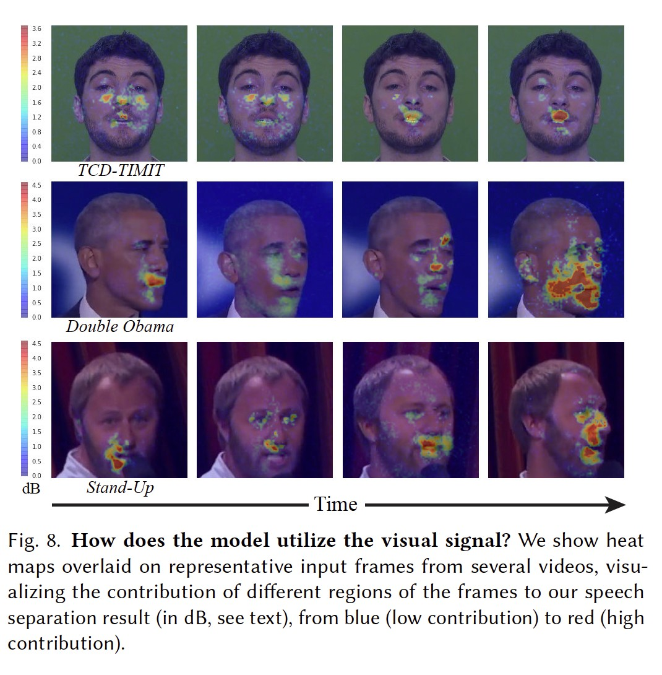
05
Experiments
Results
The face regions that contribute the
most are located around mouth.
35 /36

Slide 27
6
Conclusion

Slide 28
06
Conclusion
Audio-visual Neural Network-based Model
01
This paper proposed an audio-visual neural network-based model for single channel, speaker-independent speech separation. This model works well in challenging scenarios, including multi-speaker mixtures with background noise.
AVSpeech Dataset
02
we created a new audio- visual dataset with thousands of hours of video segments containing visible speakers and clean speech we collected from the Web.
Applications
03
This model can be useful for automatic speech recognition (ASR) and video transcription.

Slide 29
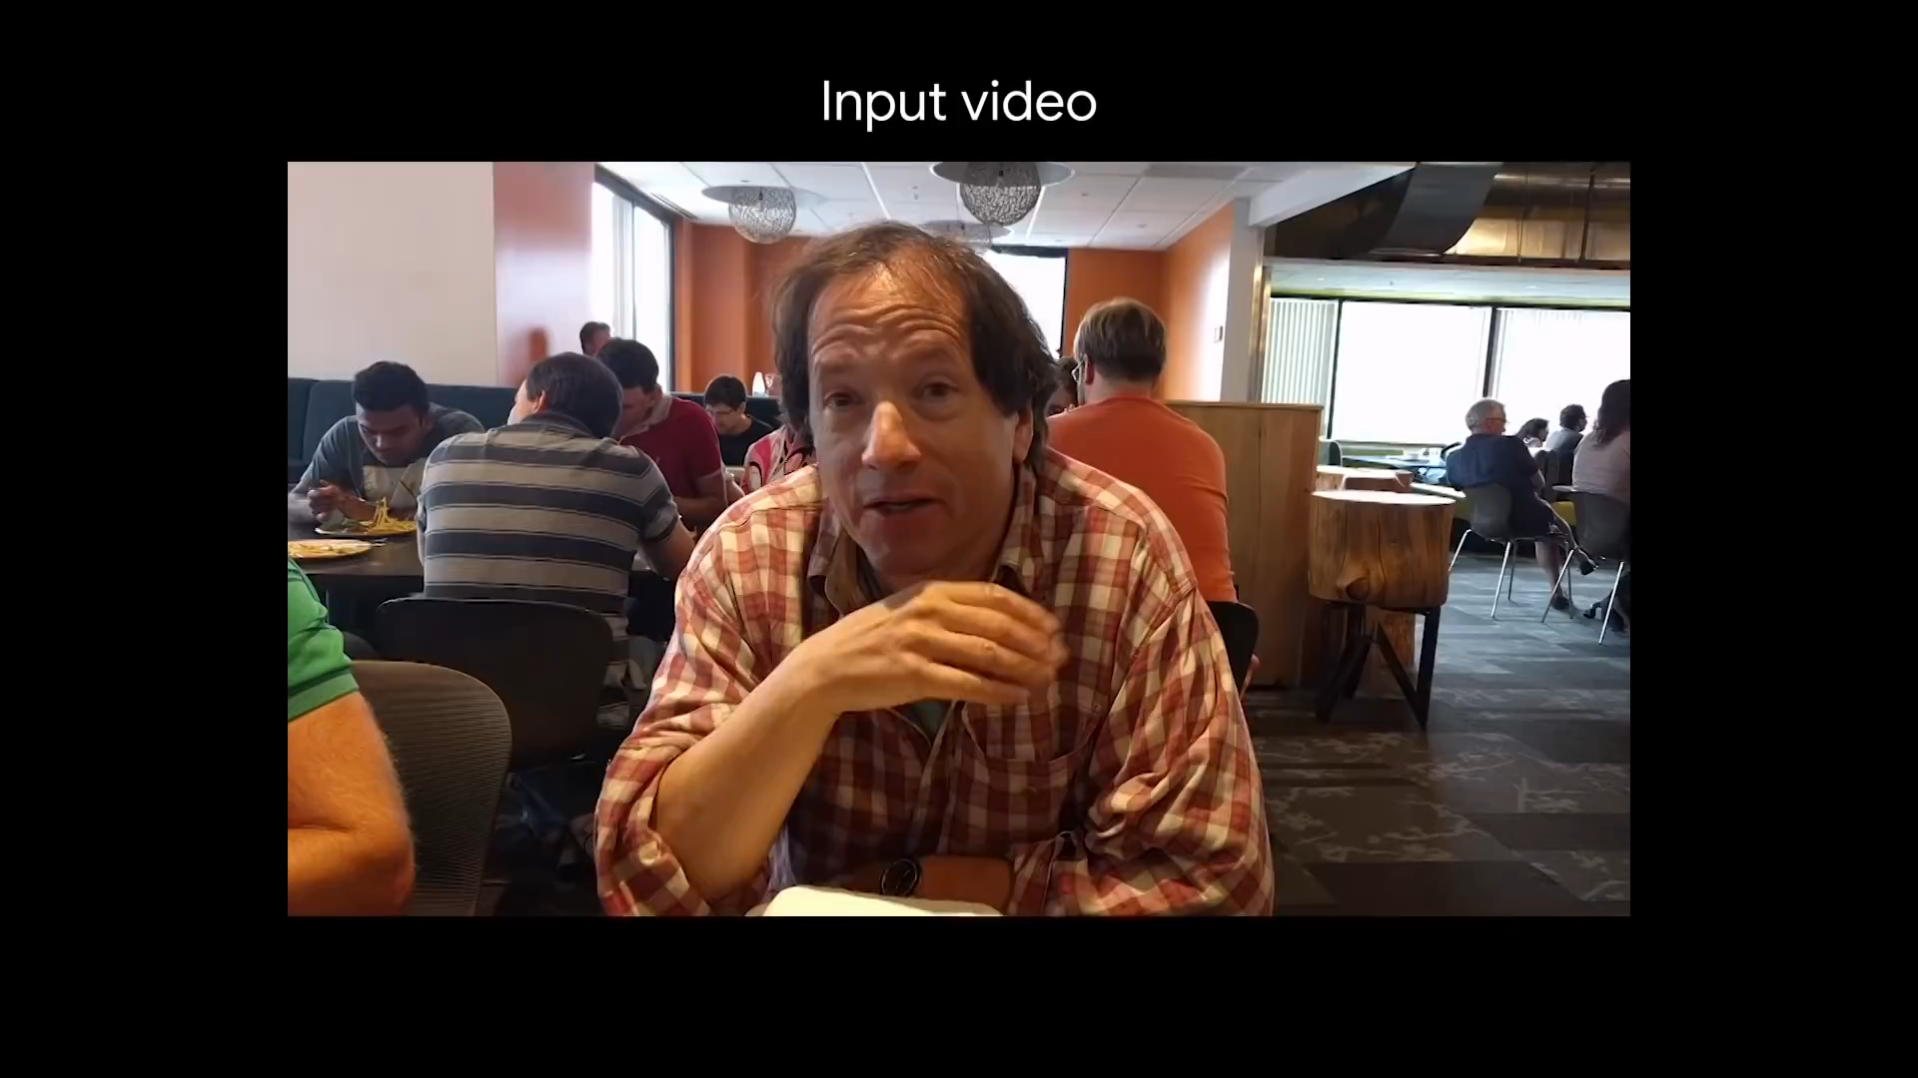
06
Conclusion

Slide 30
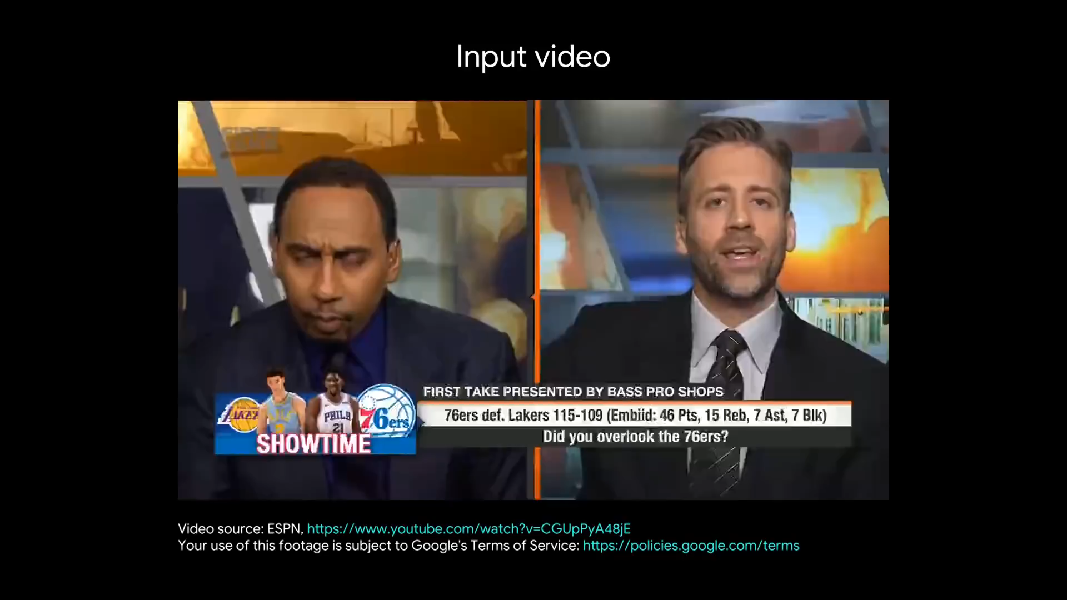
06
Conclusion

Slide 31
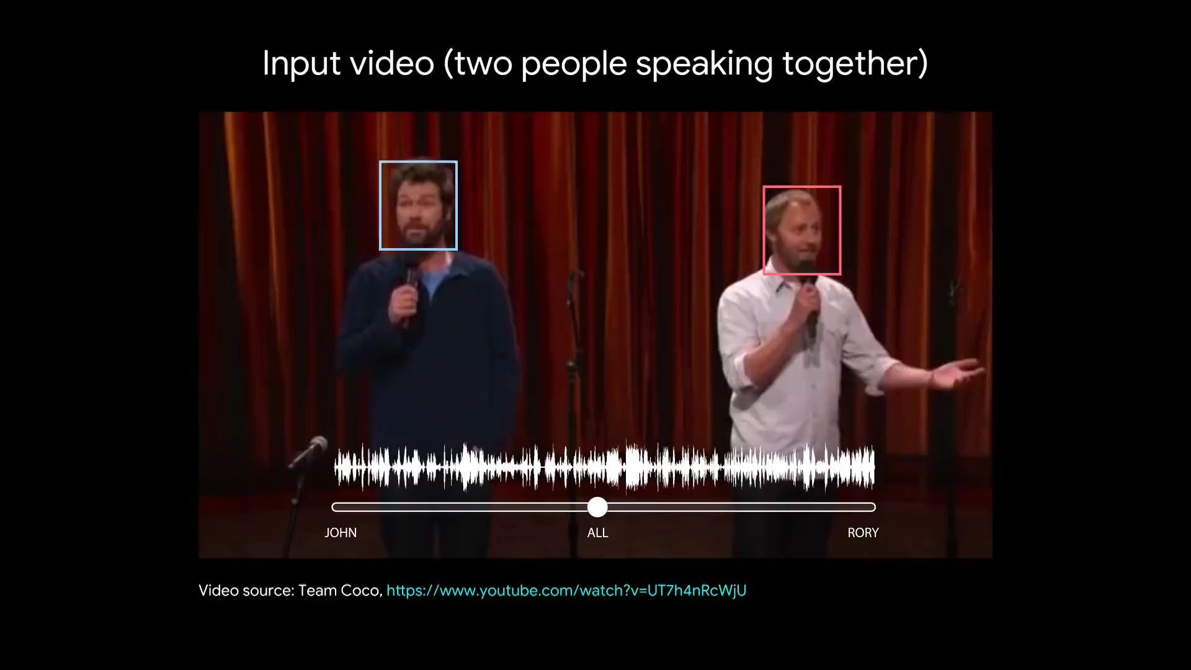
06
Conclusion

Slide 32
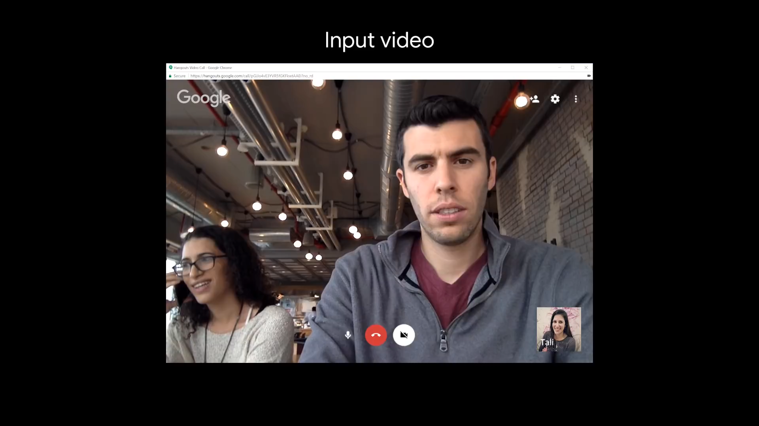
06
Conclusion

Slide 33



